Slide 1
FitBuddy_AI
IBM AICTE PROJECT
Presented By: Jay Padharia
College Name : KALINGA UNIVERSITY
Department: MCA

Slide 2
OUTLINE
Problem Statement
Technology used
Wow factor
End users
Result
Conclusion
Git-hub Link
Future scope
IBM Certifications

Slide 3
Problem Statement
Problem Statement: In today’s fast-paced lifestyle, individuals often struggle to stay consistent with fitness goals due to lack of personalized guidance, time constraints, and low motivation. Traditional fitness programs require fixed schedules, costly subscriptions, and fail to adapt to individual routines or preferences—making it difficult to maintain a healthy lifestyle.
Proposed Solution: An AI-powered virtual fitness coach that uses Natural Language Processing (NLP) and conversational intelligence to recommend personalized home workouts, suggest simple nutritious meals, deliver daily motivation, and promote habit-building—making fitness accessible, flexible, and engaging for everyone.

Slide 4
Technology used
IBM cloud lite services
Natural Language Processing (NLP)
Retrieval Augmented Generation (RAG)
IBM Granite model

Slide 5
IBM cloud services used
IBM Cloud Watsonx AI Studio
IBM Cloud Watsonx AI runtime
IBM Cloud Agent Lab
IBM Granite foundation model

Slide 6
Wow factors
This agent will help users stay consistent with their fitness goals, improve physical and mental well-being, and build long-term healthy habits—anytime, anywhere—by making fitness guidance more personalized, accessible, and motivating.
Unique Features:
Personalized home workouts tailored to user goals, fitness level, and available time
AI-generated meal suggestions based on dietary preferences and nutrition goals
Daily habit tracking with motivational nudges to build consistency
Goal-based coaching: sets micro-goals and celebrates progress
Smart reminders and adaptive routines that adjust to user schedule changes
Mood-aware check-ins: adapts tone and suggestions based on user energy or mood
Conversational interface using NLP, powered by IBM Watson (Granity), for an engaging and human-like experience

Slide 7
End users
Busy professionals
Students
Remote workers
Fitness beginners
Home-based individuals
Recovery and rehab users
Health-conscious individuals

Slide 8
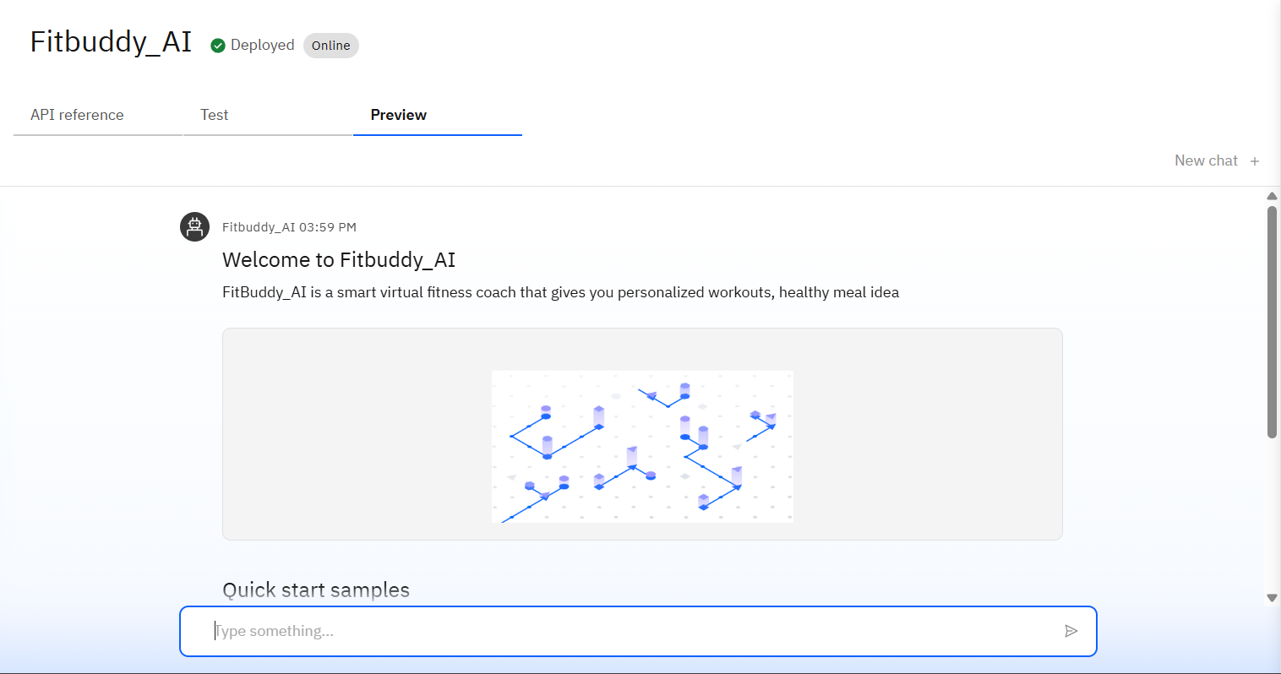
Results

Slide 9
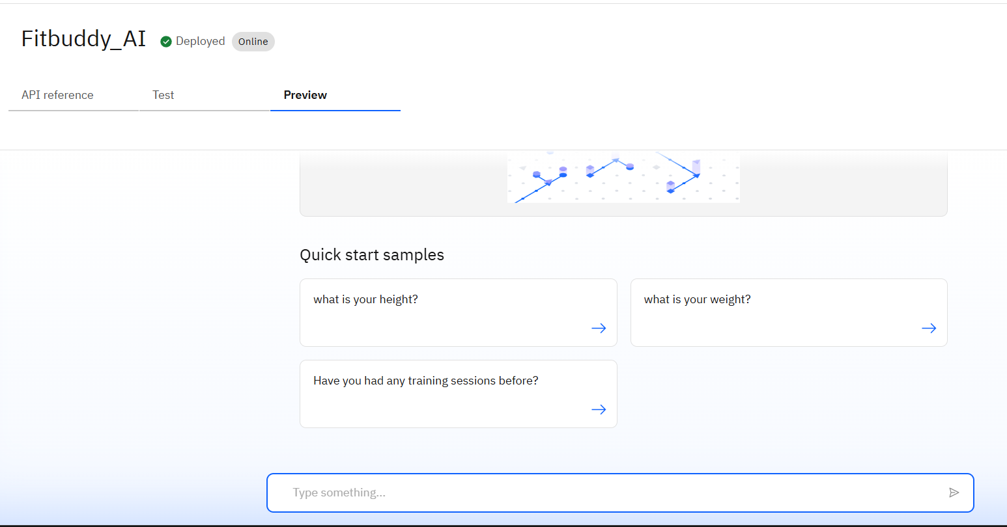
Results

Slide 10
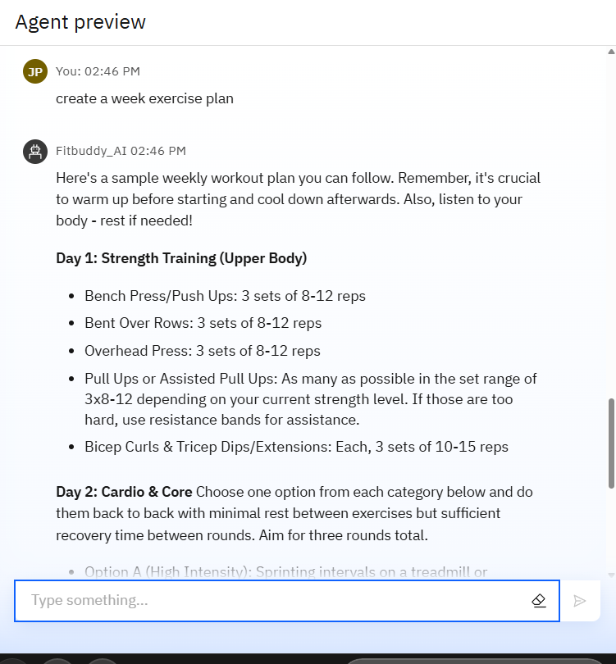
Results

Slide 11
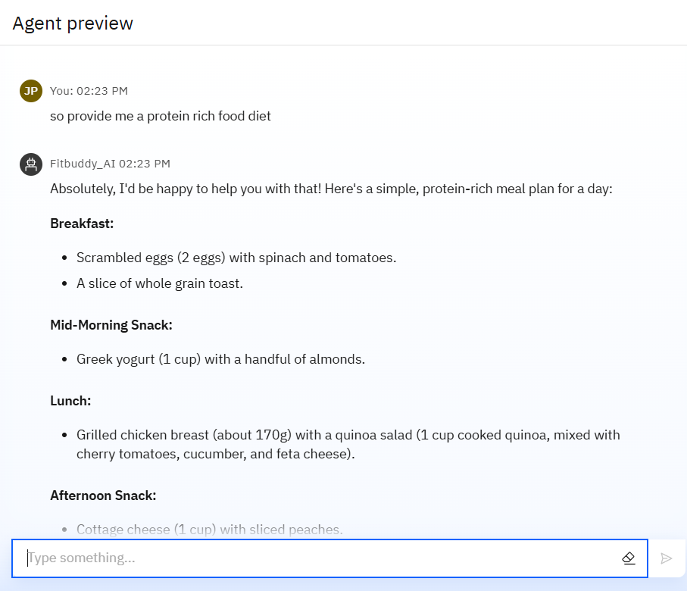
Results

Slide 12
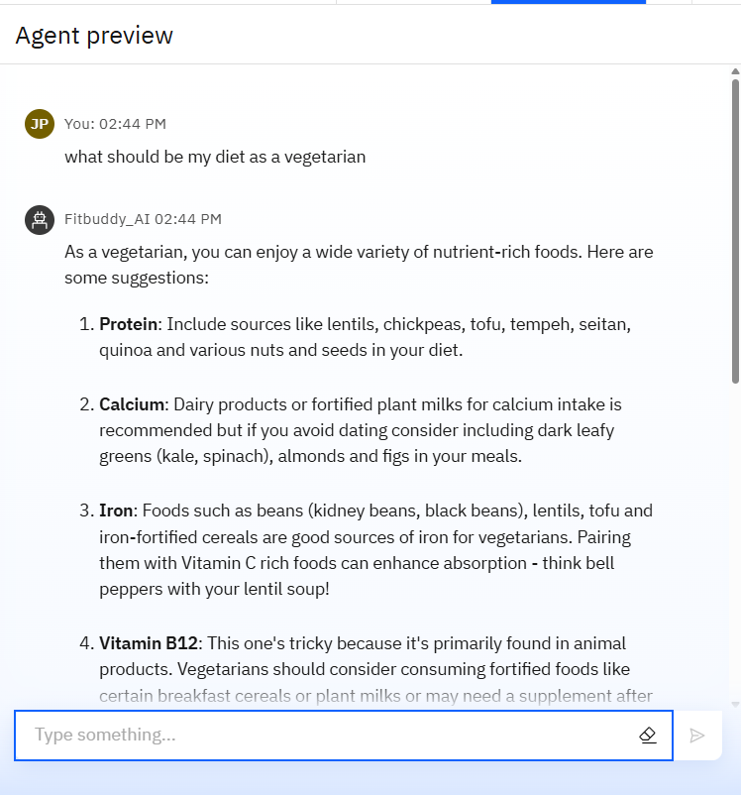
Results

Slide 13
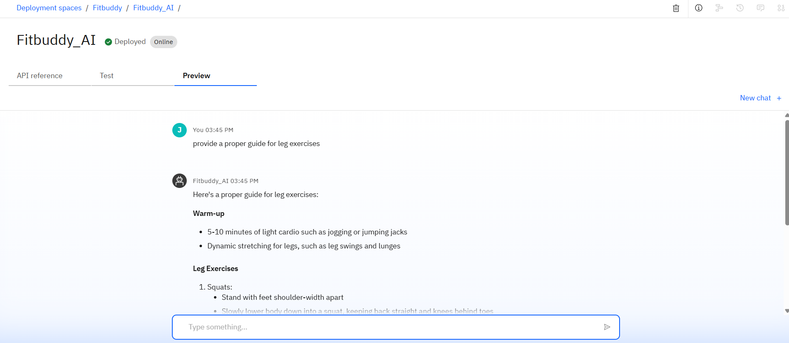
Results

Slide 14
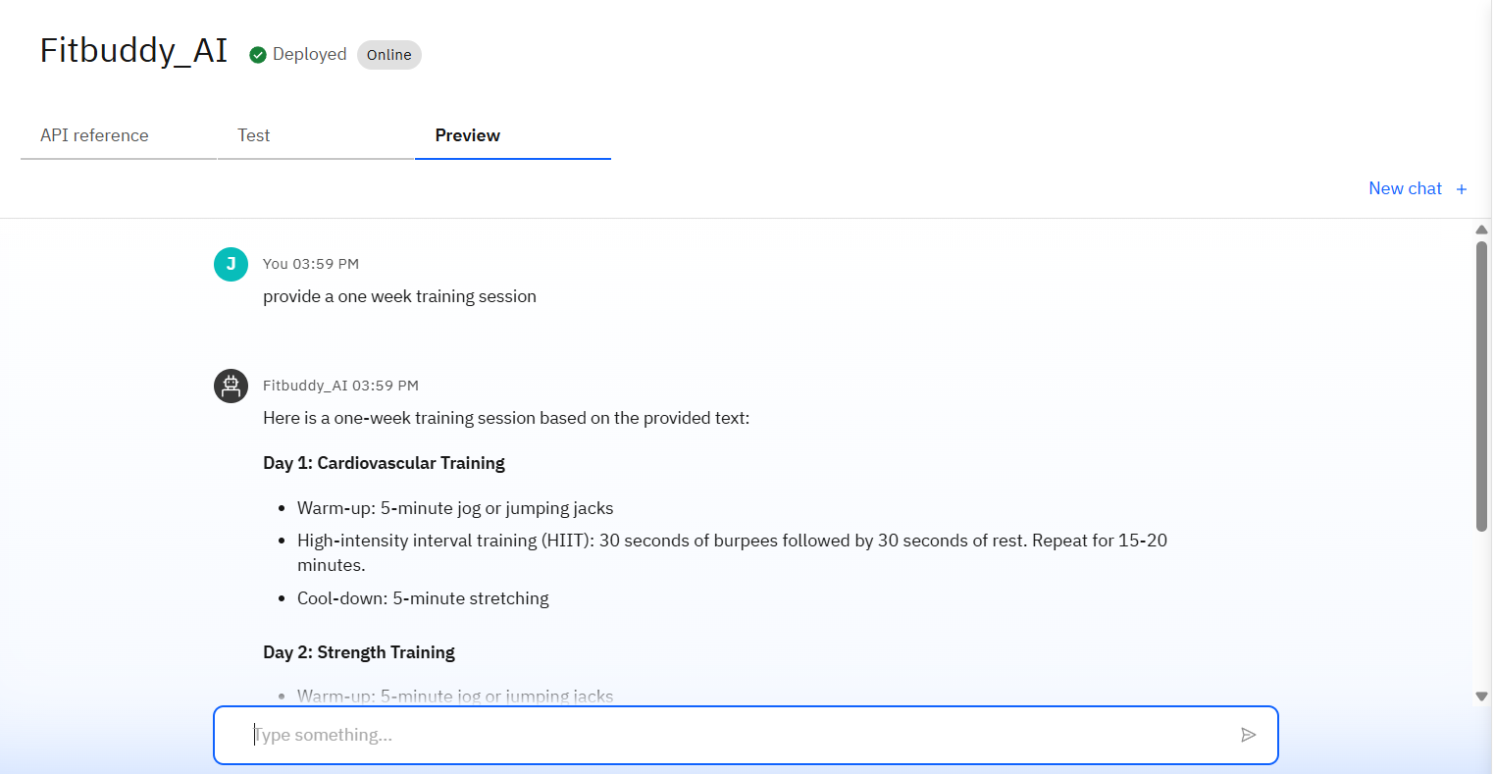
Results
Deployed AI Agent

Slide 15
Conclusion
🔹 FitBuddy AI can generate personalized workout plans, offer dietary suggestions, and even adapt routines based on user progress. 🔹 It saves time by automating fitness tracking, goal monitoring, and daily reminders. 🔹 FitBuddy enhances motivation, accountability, and overall well-being across all fitness levels. 🔹 It provides real-time feedback using sensor data or user input to improve form and prevent injuries. 🔹 FitBuddy supports long-term consistency through gamified challenges, progress badges, and AI-driven encouragement.

Slide 16
GitHub Link
Github repo- https://github.com/Vaibhav-padharia/Fitbuddy_AI-

Slide 17
Future scope
🔹 AI-Powered Mental Wellness Support 🔹 Integration with Wearables 🔹 Voice-Based Workout Assistant 🔹 Adaptive Injury Recovery Plans 🔹 Social Fitness Challenges 🔹 Personalized Nutrition AI

Slide 18
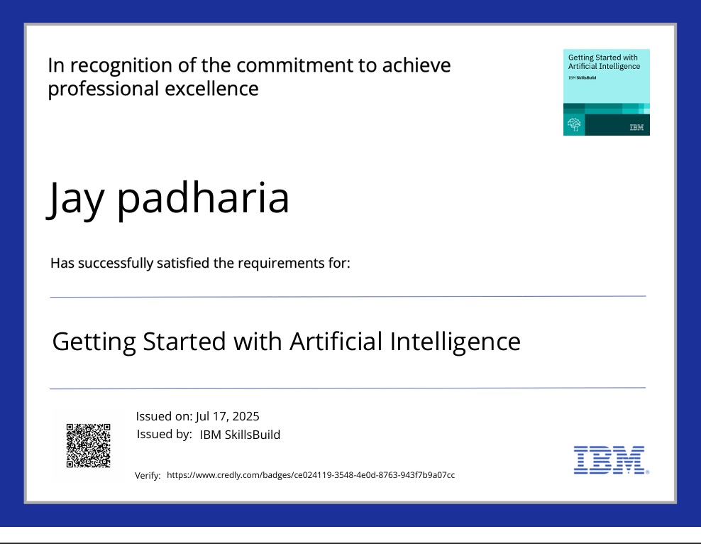
IBM Certifications
Screenshot/ credly certificate( getting started with AI)

Slide 19
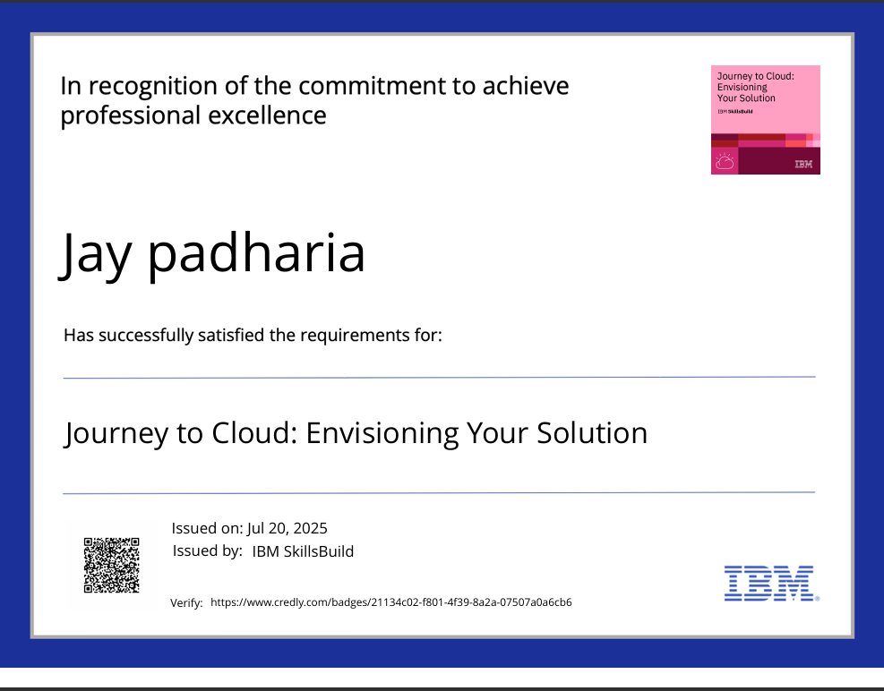
IBM Certifications
Screenshot/ credly certificate( Journey to cloud )

Slide 20
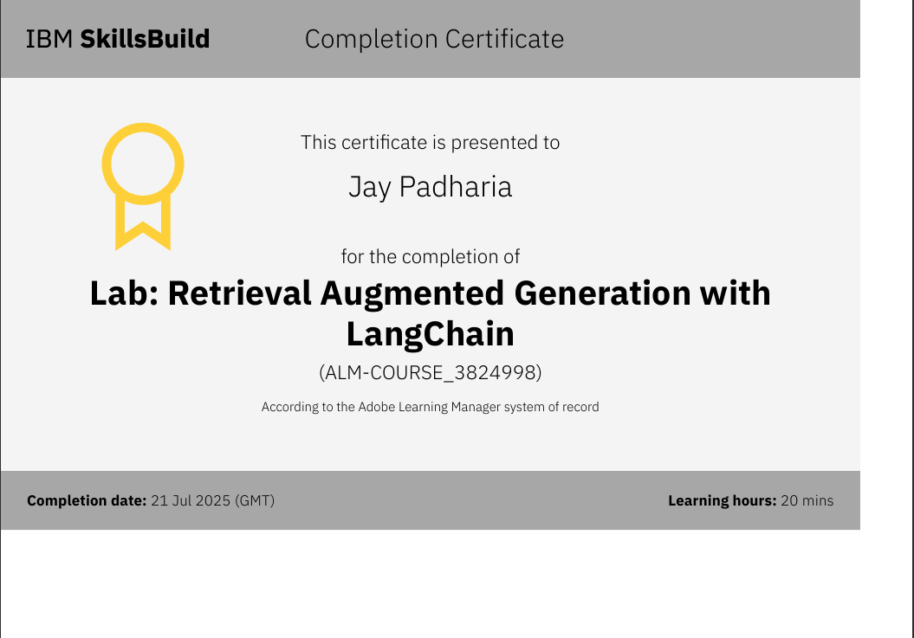
Attach your RAG LAB certificate here

Slide 21
THANK YOU

